Slide 1
Bloom’s Taxonomy & Sequential Logic
Bloom’s Taxonomy, Cornell Note Taking Method, Representing Time in Hardware, Sequential Logic

Slide 2
Lecture Outline
Bloom’s Taxonomy
Applying Higher Levels of Cognition to Learning
Cornell Note Taking Method
System for Taking, Organizing, and Reviewing Notes
Representing Time in Hardware
Sequential Logic vs. Combinational Logic
Adding a Clock
Sequential Logic
Data Flip-Flop (DFF) Implementation and Examples

Slide 3
Bloom’s Taxonomy
Creating
Producing something new
Justifying your decisions or position
Evaluating
Drawing connections among ideas
Analyzing
Using information in a new (or similar) situation
Applying
Understanding
Explaining ideas or concepts
Remembering
Recalling facts and basic concepts

Slide 4
Bloom’s Taxonomy in Action
Creating
Creating your own Java objects in your CSE 143 assignments
Justifying why one would use a particular Java object (ArrayList)?
Evaluating
How do Java objects relate to other real-word tools?
Analyzing
Using Java objects defined in the standard class libraries
Applying
Understanding
Understanding the use Java objects
Remembering
Remembering what Java objects are

Slide 5
Lecture Outline
Bloom’s Taxonomy
Applying Higher Levels of Cognition to Learning
Cornell Note Taking Method
System for Taking, Organizing, and Reviewing Notes
Representing Time in Hardware
Sequential Logic vs. Combinational Logic
Adding a Clock
Sequential Logic
Data Flip-Flop (DFF) Implementation and Examples

Slide 6
Cornell Note Taking Method
Questions
Notes
Main Topic
Sub point
definition
example **
Object-Oriented Programming
Encapsulates the data and the operations for a given data type
Provides abstractions - you don’t need to know how a car is implemented in order to use it
Extensibility - easier to add new data types
Functional Programming
Extensibility - easier to add new operations
Compose a question that corresponds to the notes you took
In what ways is object-oriented programming more extensible than functional programming?
Summary
Object-oriented programming and functional programming are two types of programming paradigms…

Slide 7
Cornell Note Taking Method
Questions
Notes
Main Topic
Sub point
definition
example **
Object-Oriented Programming
Encapsulates the data and the operations for a given data type
Provides abstractions - you don’t need to know how a car is implemented in order to use it
Extensibility - easier to add new data types
Functional Programming
Extensibility - easier to add new operations
Compose a question that corresponds to the notes you took
In what ways is object-oriented programming more extensible than functional programming?
Summary
Object-oriented programming and functional programming are two types of programming paradigms…

Slide 8
Applying the Cornell Note-Taking Method
You are going to try it… TODAY!
Thursday you will come & contrast Cornell notes with your classmates
You are also going to try it with one of your other classes as part of Project 4 (more on Thursday)

Slide 9
Lecture Outline
Bloom’s Taxonomy
Applying Higher Levels of Cognition to Learning
Cornell Note Taking Method
System for Taking, Organizing, and Reviewing Notes
Representing Time in Hardware
Sequential Logic vs. Combinational Logic
Adding a Clock
Sequential Logic
Data Flip-Flop (DFF) Implementation and Examples

Slide 10
Which of the following statements about sequential logic is FALSE?
We represent time with a clock signal that alternates between high and low signals
The DFF allows us to reuse outputs as inputs in a circuit
The outputs for a DFF at time t=2 is determined by the inputs at time t=3
Sequential logic is important because it addresses slight delays caused in circuit gates
We’re lost…

Slide 11
Combinational vs. Sequential Logic
So far, we have ignored “time” in our circuits
Our chips use combinational logic
When given inputs, the chip computes its output instantaneously
The output is a function of the current inputs, with no memory of previous events
Today, we’ll start exploring what happens when we consider time, ultimately building to sequential logic

Slide 12
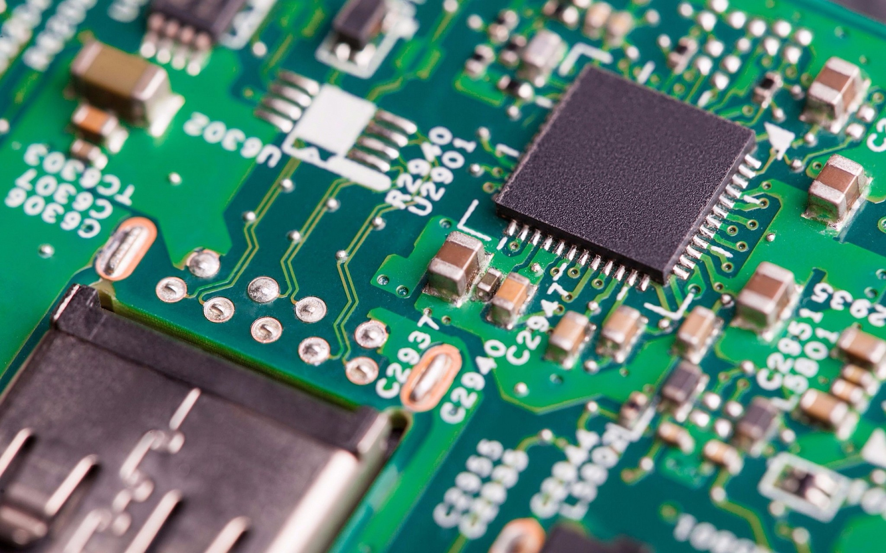
Why Consider Time Now?
Needed for our abstraction
We need to talk about hardware maintaining state for memory
We need vocabulary to talk about time
Needed for our implementation
Physical implementations of chips cannot be instantaneous
We need to account for physical delays in signal propagation

Slide 13
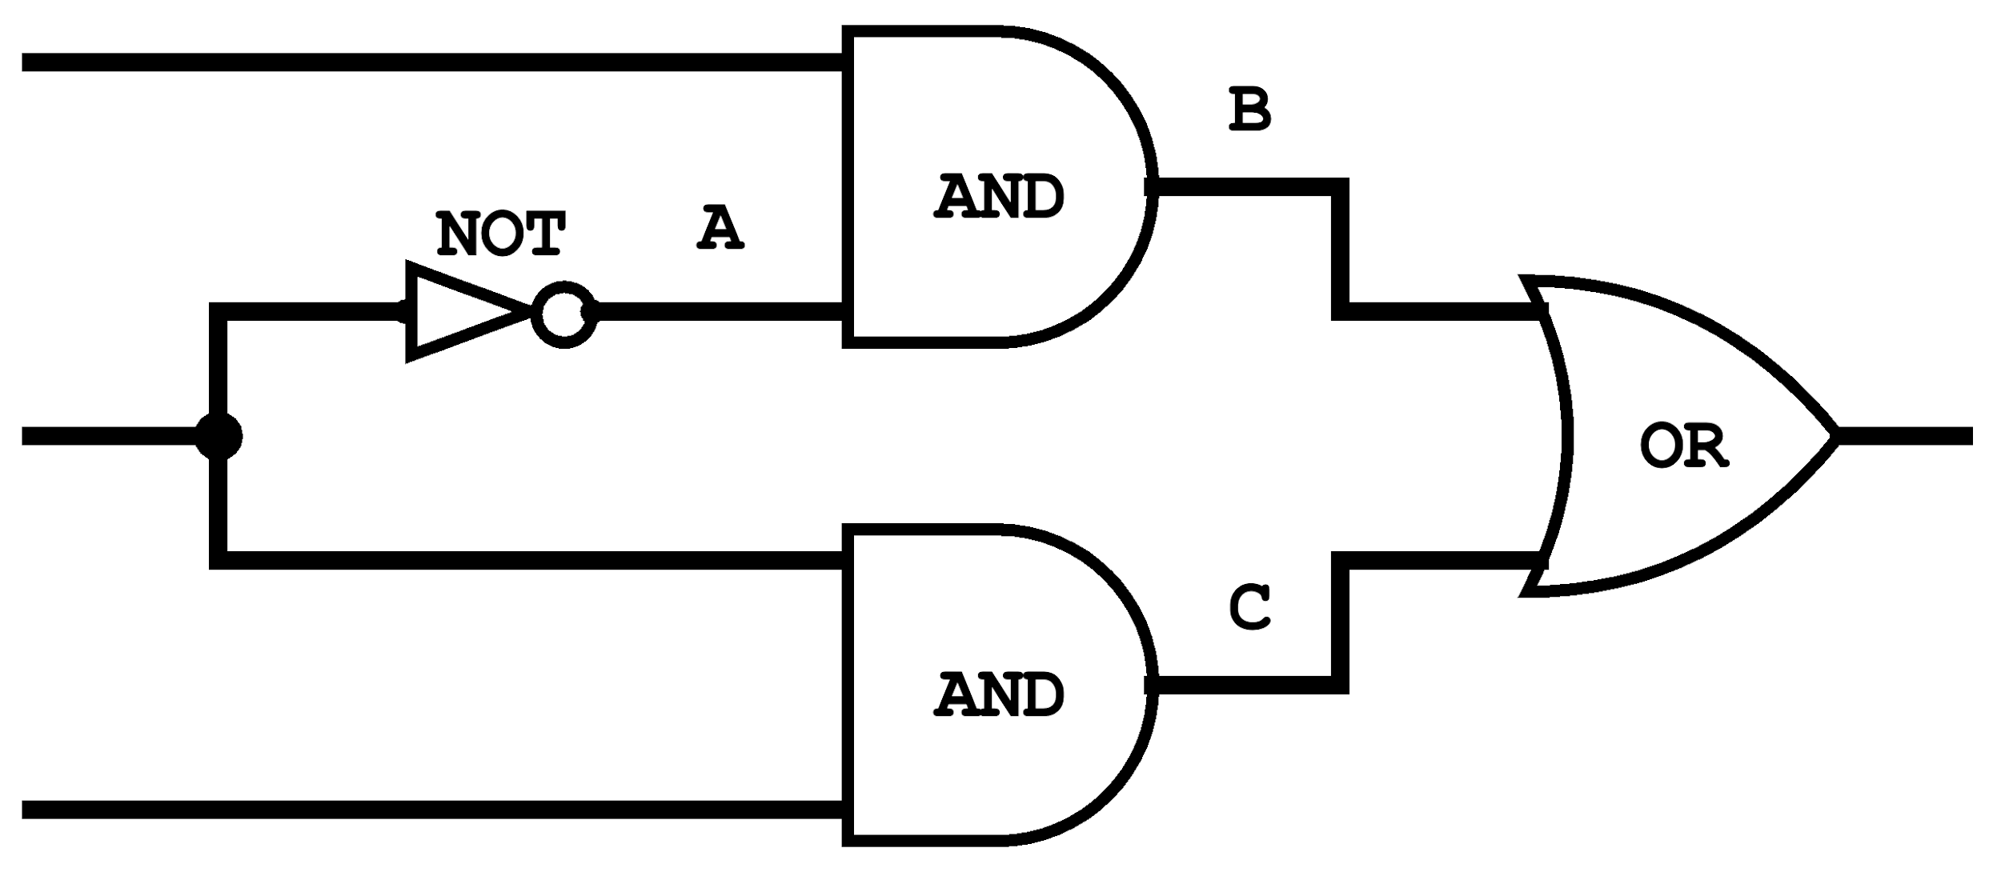
Autopilot Control Circuit Example
Consider this autopilot control circuit:
Either the pilot or copilot is flying at any time
The pilot and copilot can separately request autopilot
Only the person flying can request autopilot
Copilot Autopilot Request
Pilot flying?
Autopilot Engaged
Pilot Autopilot Request

Slide 14
Autopilot Control Circuit Example
Consider this autopilot control circuit:
Either the pilot or copilot is flying at any time
The pilot and copilot can separately request autopilot
Only the person flying can request autopilot
Let’s assume every logic gate takes 1ms to compute
For example, if an input changes at t=4ms, the gate will only output the new result at t=5ms
Copilot Autopilot Request
Pilot flying?
Autopilot Engaged
Pilot Autopilot Request

Slide 15
Autopilot Control Circuit Example
Copilot Autopilot Request
Pilot Flying?
Autopilot Engaged
Pilot Autopilot Request
CAR | 1 | 1 | 1 | 1 | 1 | 1
PF | 1 | 0 | 0 | 0 | 0 | 0
PAR | 1 | 1 | 1 | 1 | 1 | 1
A | 0
B | 0
C | 1
AE | 1
0ms
1ms
2ms
3ms
4ms
5ms
6ms

Slide 16
Autopilot Control Circuit Example
Copilot Autopilot Request
Pilot Flying?
Autopilot Engaged
Pilot Autopilot Request
CAR | 1 | 1 | 1 | 1 | 1 | 1
PF | 1 | 0 | 0 | 0 | 0 | 0
PAR | 1 | 1 | 1 | 1 | 1 | 1
A | 0
B | 0
C | 1
AE | 1
??
0ms
1ms
2ms
3ms
4ms
5ms
6ms

Slide 17
Autopilot Control Circuit Example
Copilot Autopilot Request
Pilot Flying?
Autopilot Engaged
Pilot Autopilot Request
CAR | 1 | 1 | 1 | 1 | 1 | 1
PF | 1 | 0 | 0 | 0 | 0 | 0
PAR | 1 | 1 | 1 | 1 | 1 | 1
A | 0 | 0
B | 0
C | 1
AE | 1
0ms
1ms
2ms
3ms
4ms
5ms
6ms

Slide 18
Autopilot Control Circuit Example
Copilot Autopilot Request
Pilot Flying?
Autopilot Engaged
Pilot Autopilot Request
CAR | 1 | 1 | 1 | 1 | 1 | 1
PF | 1 | 0 | 0 | 0 | 0 | 0
PAR | 1 | 1 | 1 | 1 | 1 | 1
A | 0 | 0 | ?
B | 0
C | 1
AE | 1
0ms
1ms
2ms
3ms
4ms
5ms
6ms

Slide 19
Autopilot Control Circuit Example
Copilot Autopilot Request
Pilot Flying?
Autopilot Engaged
Pilot Autopilot Request
CAR | 1 | 1 | 1 | 1 | 1 | 1
PF | 1 | 0 | 0 | 0 | 0 | 0
PAR | 1 | 1 | 1 | 1 | 1 | 1
A | 0 | 0 | 1
B | 0
C | 1
AE | 1
0ms
1ms
2ms
3ms
4ms
5ms
6ms

Slide 20
Describe the behavior of the Autopilot Engaged (AE) output between 1ms to 6ms.
Copilot Autopilot Request
Pilot Flying?
Autopilot Engaged
Pilot Autopilot Request
CAR | 1 | 1 | 1 | 1 | 1 | 1
PF | 1 | 0 | 0 | 0 | 0 | 0
PAR | 1 | 1 | 1 | 1 | 1 | 1
A | 0 | 0 | 1
B | 0
C | 1
AE | 1
0ms
1ms
2ms
3ms
4ms
5ms
6ms

Slide 21
Describe the behavior of the Autopilot Engaged (AE) output between 1ms to 6ms.
Copilot Autopilot Request
Pilot Flying?
Autopilot Engaged
Pilot Autopilot Request
CAR | 1 | 1 | 1 | 1 | 1 | 1
PF | 1 | 0 | 0 | 0 | 0 | 0
PAR | 1 | 1 | 1 | 1 | 1 | 1
A | 0 | 0 | 1 | 1 | 1 | 1
B | 0 | 0 | 0 | 1 | 1 | 1
C | 1 | 1 | 0 | 0 | 0 | 0
AE | 1 | 1 | 1 | 0 | 1 | 1
0ms
1ms
2ms
3ms
4ms
5ms
6ms

Slide 22
Autopilot Control Circuit Example
Copilot Autopilot Request
Critical Path
Pilot Flying?
Autopilot Engaged
Pilot Autopilot Request
CAR | 1 | 1 | 1 | 1 | 1 | 1
PF | 1 | 0 | 0 | 0 | 0 | 0
PAR | 1 | 1 | 1 | 1 | 1 | 1
A | 0 | 0 | 1 | 1 | 1 | 1
B | 0 | 0 | 0 | 1 | 1 | 1
C | 1 | 1 | 0 | 0 | 0 | 0
AE | 1 | 1 | 1 | 0 | 1 | 1
0ms
1ms
2ms
3ms
4ms
5ms
6ms

Slide 23
Physical Timekeeping
Hardware keeps track of time using an alternating signal
Creates the idea of discrete time: state changes only occur in discrete intervals, right when signal alternates
Physical Time
Clock Signal
1
0

Slide 24
Physical Timekeeping
Hardware keeps track of time using an alternating signal
Creates the idea of discrete time: state changes only occur in discrete intervals, right when signal alternates
Physical Time
Clock Signal
1
0
t=0
t=1
t=2
t=3
t=4
Discrete Time Intervals

Slide 25

Adding a Clock: Ideal
We want this behavior from a simple, combinational Not gate:
Clock Signal
1
0
1
in
0
1
out
0
t=0
t=1
t=2
t=3
t=4

Slide 26
Adding a Clock: Reality
Combinational logic may be incorrect for a period immediately after inputs change
Computation delays (logic gates) and propagation delays (wires)
Clock Signal
1
0
In the autopilot example, this arrow would represent the 3ms of uncertainty after inputs change
1
in
0
1
out
0
t=0
t=1
t=2
t=3
t=4
Notes:
To be super precise, previously, in the autopilot example, we talked about the bottom being milliseconds. Here, we are talking about clock cycles or time intervals.
The curves here represent some uncertainty about when the change occurs from one clock interval to another clock interval.
Abstractions are everywhere! Even the clock signal here, is an abstraction. It’s probably one of the lowest level abstractions that we as computer scientists and computer engineers will notice. That this clock signal here is an abstraction. Like, it’s impossible for a voltage to change from 0-5V or from 5-0V instantaneously.
Efficiency. 20ms vs 1ms, 20ms, absolutely wasted efficiency. Can we distribute the delay somehow, to make it as evenly distributed as possible.

Slide 27
Adding a Clock: Clock Cycles
Choose a clock cycle length slightly longer than the delays
> 3ms
Clock Signal
1
0
1
in
0
1
out
0
t=0
t=1
t=2
t=3
t=4

Slide 28
Adding a Clock: Abstraction
If we use a long enough clock cycle, we can pretend that combinational chips (like Not) work instantly
Clock Signal
1
0
1
in
0
1
out
0
t=0
t=1
t=2
t=3
t=4

Slide 29
Five-minute Break!
Feel free to stand up, stretch, use the restroom, drink some water, review your notes, or ask questions
We’ll be back at:
Any song recommendations? Respond on Poll Everywhere at https://pollev.com/cse390b
Research shows mid-lecture breaks reduce the decline of attention in the middle of lecture (Olmsted, 1999)
Olmsted III, John. “The Mid-Lecture Break: When Less Is More.” Journal of Chemical Education (1999). https://pubs.acs.org/doi/abs/10.1021/ed076p525.

Slide 30
When is a (or are) better time(s) for Eric’s Wednesday office hours (previously Wednesdays from 1:30-2:30pm)?
Wednesdays, 11:30-12:30pm
Wednesdays, 5:30-6:30pm
Thursdays, 11:30-12:30pm
Thursdays, 12:30-1:30pm
The time is good as is (Wednesdays, 1:30-2:30pm)

Slide 31
Lecture Outline
Bloom’s Taxonomy
Applying Higher Levels of Cognition to Learning
Cornell Note Taking Method
System for Taking, Organizing, and Reviewing Notes
Representing Time in Hardware
Sequential Logic vs. Combinational Logic
Adding a Clock
Sequential Logic
Data Flip-Flop (DFF) Implementation and Examples

Slide 32
Combinational vs. Sequential Abstraction
Clock Signal
1
0
Combinational: a function of the current inputs
in
a
b
c
d
e
out
f(a)
f(b)
f(c)
f(d)
f(e)
Sequential: a function of previous inputs (has “memory”)
in
a
b
c
d
e
out
f(a)
f(b)
f(c)
f(d)
t=0
t=1
t=2
t=3
t=4

Slide 33
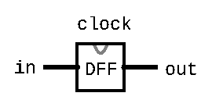
The Flip-Flop Gate
Simplest state-keeping component
1-bit input, 1-bit output
Wired to the clock signal
Always outputs its previous input: out(t) = in(t-1)
Implementation: a gate that can flip between two stable states (remembering 0 vs. remembering 1)
Gates with this behavior are “Data Flip Flops” (DFFs)

Slide 34
Aside: Treating Flip-Flop as Primitive
Disclaimer: CAN be made from Nand gates exclusively!
But requires wiring them together in a “messy” loop that the hardware simulator can’t simulate and isn’t very educational
For simplicity, we will treat Flip-Flop as primitive in the projects
Just like Nand, you can use the built-in implementation

Slide 35
Flip-Flop Behavior
1
Clock Signal
0
1
in
0
out
1
0
t=0
t=1
t=2
t=3
t=4

Slide 36
Sequential Chips
A category of chips that utilize the clock signal, in addition to any combinational logic
Capable of:
Maintaining state
Optionally, acting on that state and the current inputs
Can incorporate combinational logic as well
Constructed from:
DFFs
Combinational logic (which is entirely constructed from Nand)

Slide 37
Sequential Chips
output(t) = f(state(t-1), input(t))
DFF
Combinational Logic
f
input
DFF
output
DFF

Slide 38
Flip-Flop: Time Series
DFF Specification:
out(t) = in(t-1)
in | 0 | 0 | 1 | 1 | 0 | 1 | 0 | ...
out | 0 | 0 | 0 | 1 | 1 | 0 | 1 | ...
time | t=0 | t=1 | t=2 | t=3 | t=4 | t=5 | t=6 | ...
Example: out(t=3) = in(t=2)

Slide 39
DFF Example 1: Specification
Example specification:
out(t) = Xor(a(t-1), b(t-1))
Takes two inputs, a and b, and outputs the Xor of them
Note that out at time t is determined by a and b at time t-1
We will need to use a DFF
Exercise: Draw out the corresponding circuit diagram

Slide 40
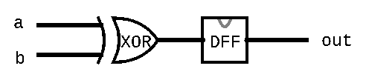
DFF Example 1: Circuit Diagram
Example specification:
out(t) = Xor(a(t-1), b(t-1))
Circuit diagram:

Slide 41
DFF Example 1: HDL Implementation
CHIP Example1 {
IN a, b;
OUT out;
PARTS:
Xor(a=a, b=b, out=xorout);
DFF(in=xorout, out=out);
}

Slide 42
DFF Example 1: Time Series
Example specification:
out(t) = Xor(a(t-1), b(t-1))
a | 0 | 0 | 1 | 1 | 1 | 0 | 0 | ...
b | 0 | 1 | 0 | 1 | 1 | 1 | 0 | ...
out | 0 | 0 | 1 | 1 | 0 | 0 | 1 | ...
time | t=0 | t=1 | t=2 | t=3 | t=4 | t=5 | t=6 | ...
Example: out(t=3) = Xor(a(t=2), b(t=2))

Slide 43
DFF Example 2: Specification
Example specification:
out(t) = Xor(out(t-1), in(t-1))
Notice how the specification uses out(t-1) as an input for out(t)
Implies the necessity of circular wiring, separated by a DFF
Exercise: Draw out the corresponding circuit diagram

Slide 44
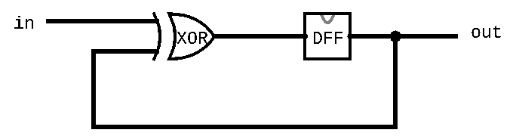
DFF Example 2: Circuit Diagram
Example specification:
out(t) = Xor(out(t-1), in(t-1))
Circuit diagram:

Slide 45
DFF Example 2: HDL Implementation
Example specification:
out(t) = Xor(out(t-1), in(t-1))
Exercise: Write out the HDL Implementation

Slide 46
DFF Example 2: HDL Implementation
Example specification:
out(t) = Xor(out(t-1), in(t-1))
Exercise: Write out the HDL Implementation
CHIP Example2 {
IN in;
OUT out;
PARTS:
Xor(a=in, b=prevout, out=xorout);
DFF(in=xorout, out=prevout, out=out);
}

Slide 47
DFF Example 2: Time Series
Example specification:
out(t) = Xor(out(t-1), in(t-1))
in | 0 | 0 | 1 | 1 | 1 | 0 | 0 | ...
out | 0 | 0 | 0 | 1 | 0 | 1 | 1 | ...
time | t=0 | t=1 | t=2 | t=3 | t=4 | t=5 | t=6 | ...
Example: out(t=1) = Xor(in(t=0), out(t=0))

Slide 48
DFF Example 3: Specification
Example specification:
out(t) = And(Not(out(t-1)), in(t-1))
Exercise: Draw out the corresponding circuit diagram

Slide 49
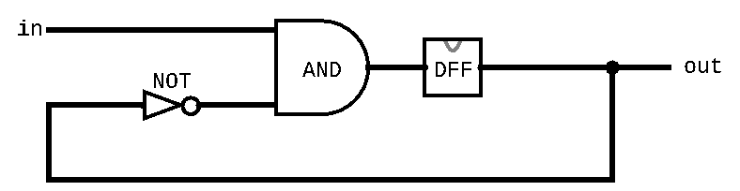
DFF Example 3: Circuit Diagram
Example specification:
out(t) = And(Not(out(t-1)), in(t-1))
Exercise: Draw out the corresponding circuit diagram

Slide 50
DFF Example 3: HDL Implementation
Example specification:
out(t) = And(Not(out(t-1)), in(t-1))
Exercise: Write out the HDL Implementation

Slide 51
DFF Example 3: HDL Implementation
Example specification:
out(t) = And(Not(out(t-1)), in(t-1))
Exercise: Write out the HDL Implementation
CHIP Example3 {
IN in;
OUT out;
PARTS:
Not(in=prevout, out=notprevout);
And(a=in, b=notprevout, out=andout);
DFF(in=andout, out=prevout, out=out);
}

Slide 52
DFF Example 3: Time Series
Example specification:
out(t) = And(Not(out(t-1)), in(t-1))
in | 1 | 1 | 0 | 1 | 1 | 0 | 0 | ...
out | 0 | 1 | 0 | 0 | 1 | 0 | 0 | ...
time | t=0 | t=1 | t=2 | t=3 | t=4 | t=5 | t=6 | ...
Example: out(t=1) = And(Not(out(t=0)), in(t=0))

Slide 53
Lecture 5 Wrap-up
Project Reminders
Project 2 grades released by Thursday (feedback can be viewed on Gradescope)
Project 3 due Thursday (4/14) at 11:59pm PDT
Lecture 6 Reading: Storing Data Using Memory
Course staff will create a guide for untagging and Eric will cover the Project 4 overview in greater depth on Thursday

